Slide 1
Engager: Quite the dilemma
You have been captured by a psychotic and evil mastermind along with 3 of your friends. He buries you all in the desert so that you are all in a straight line as shown below.
Person A can’t see anyone. Person B can’t see anyone. Person C can see Person B and Person D can see both Person B and Person C. Each person has had a hat placed on their head (that they can’t see). It is known that there are 2 white and 2 black hats. If anyone can tell the evil mastermind the colour of their own hat correctly, everyone will be set free. If anyone says an incorrect colour, the mastermind will kill everyone. Who will be the first to speak up?

Slide 2


ADT Signature Specifications
Let’s get specific!

Slide 3
Some key terminology
Abstraction
The process of taking specific examples or instances of a concept or process and using these examples to derive a general set of rules.
An Interface
A shared boundary between parts of a computer program, algorithm or data structure. The interface specifies how a data structure or program interacts with others.
An Implementation
A specific instance that implements a given interface. Just as there may be multiple ways of solving a particular problem, an interface may have several different implementations.

Slide 4

ADT Signature Specification
A formal specification acts as a contract between the users of an ADT and those creating an implementation.
An ADT specification describes the properties of the data and the OPERATIONS that it supports on that data. In this way the data and the operations that can be performed on it are coupled together by the specification.
This specification is programming language agnostic, instead forming a contract that an implementation of the data type must satisfy.
**NOTE - An ADT specification does not detail how data will be represented by an implementation.

Slide 5

ADT Signature Specification (in English)
An ADT specification tells anyone who is going to use the data type, what can and can’t be done with it.

Slide 6


Types of operations
When specifying an ADT operators typically fit into one of two categories:
Constructors: Operators used to construct or build different values of the data type.
Observers: Operators used to query the data type.

Slide 7
Constructors - some examples
Some examples of common constructor operations supported by the graph ADT.
Create: Creates an empty graph.
add node(G,u): Adds a new node u to the graph.
remove node(G,u): Removes a node u from the graph, if it exists.
add edge(G,u,v): Adds an edge from u to v.
remove edge(G, u, v): Removes an edge from u to v, if it exists.
set node attribute(G,u,attr,val): Set the value of an attribute of node u.
set edge attribute(G,e,attr,val): Set the value of an attribute of edge e.

Slide 8

Observers - some examples
Some examples of common query operations supported by the graph ADT.
Adjacent(G,u,v): Tests for whether nodes u and v are adjacent.
Neighbours(G,u): Find all the neighbours of node u.
Get node attribute(G,u,attr): Get the value of an attribute of node u.
Get edge attribute(G,e,attr): Get the value of an attribute of edge e.

Slide 9

ADT Specification: Graph
name: graph
import: list, element, boolean
operations:
empty : → graph
addNode : graph x element → graph
addEdge : graph x element x element → graph
adjacent : graph x element x element → boolean
neighbours : graph x element → list

Slide 10

ADT Specification: Queue
name: queue
import: element, boolean
operations:
empty : → queue
isEmpty : queue → boolean
enqueue : queue x element → queue
peek : queue → element
dequeue : queue → queue

Slide 11
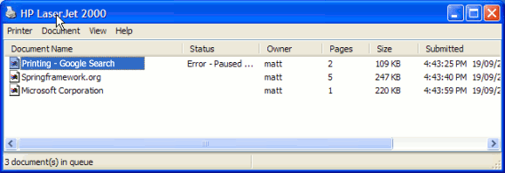


Slide 12

ADT Specification: Stack
name: stack
import: element, boolean
operations:
empty : → stack
isEmpty : stack → boolean
push : stack x element→ stack
peek : stack → element
pop : stack → stack

Slide 13
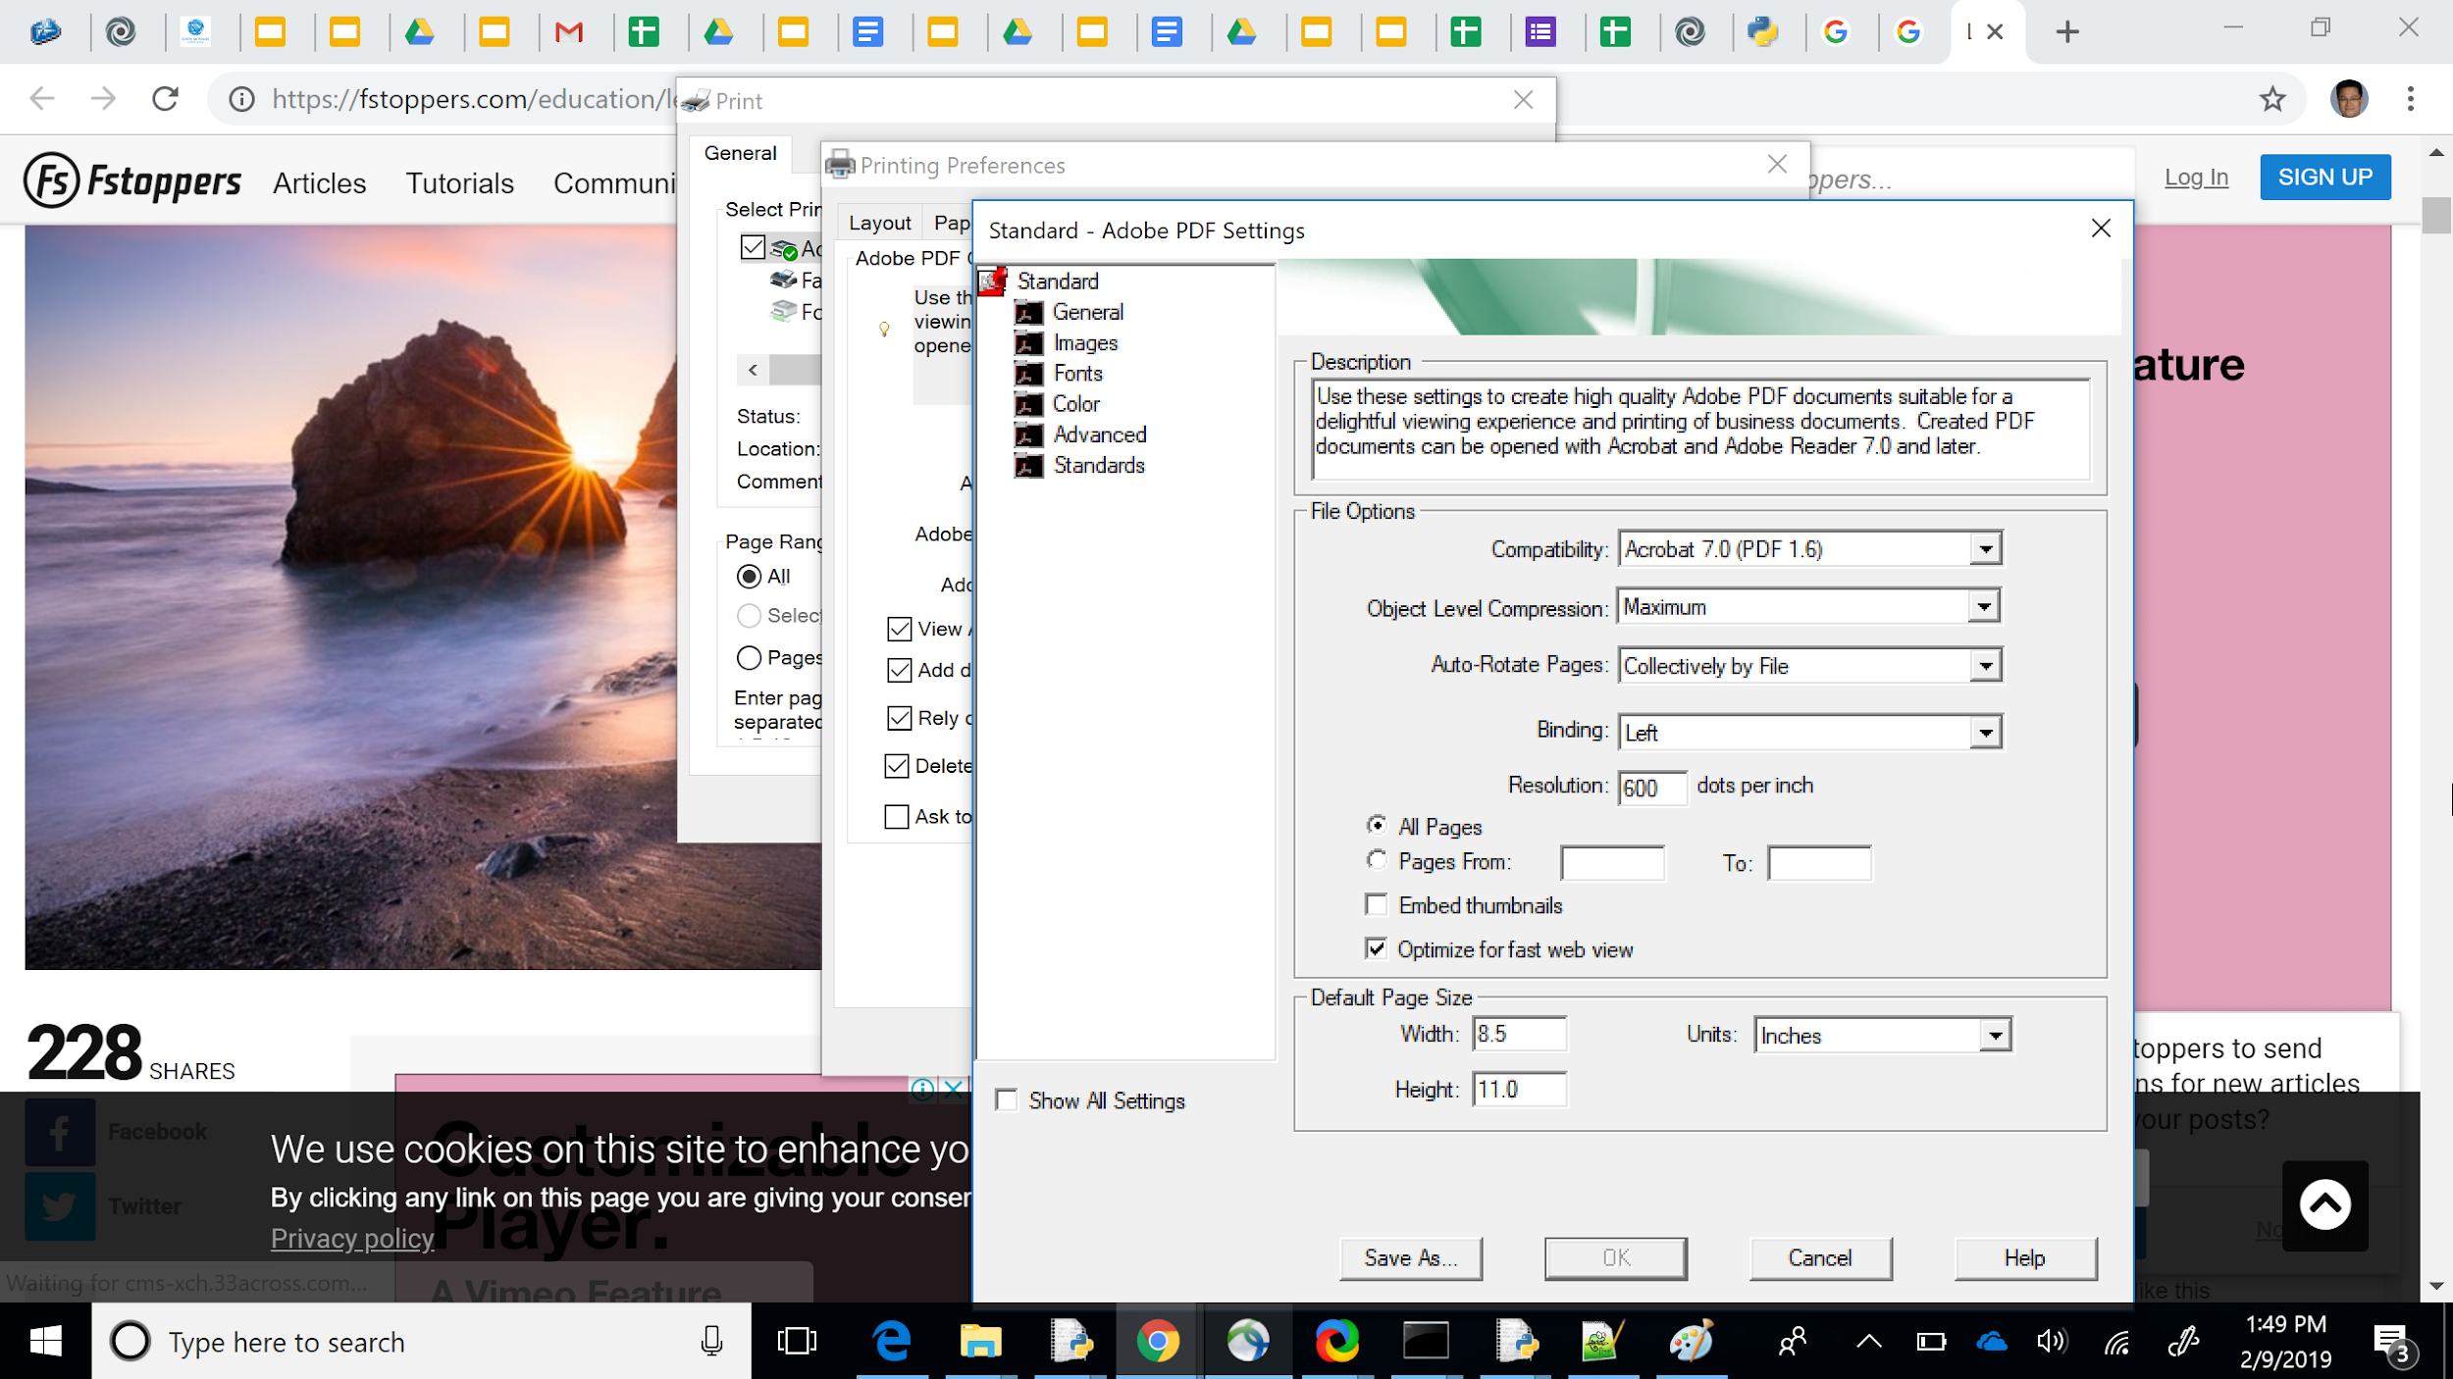

Slide 14

ADT Specification: List
name: list
import: element, boolean
operations:
empty : → list
isEmpty : list → boolean
prepend : list x element → list
head : list → element
tail : list → list

Slide 15

ADT Specification: Array
name: array
import: element, integer
operations:
create : integer → array
set : array x integer x element → array
get : array x integer → element

Slide 16

ADT Specification: Priority Queue
name: priorityQueue
import: element, integer, boolean
operations:
empty : → priorityQueue
isEmpty : priorityQueue → boolean
insertWithPriority : priorityQueue x element x integer
→ priorityQueue
getMin : priorityQueue → element
removeMin : priorityQueue → priorityQueue

Slide 17

ADT Specification: Dictionary
name: dictionary
import: element, boolean
operations:
empty : → dictionary
hasKey : dictionary x element → boolean
add : dictionary x element x element → dictionary
update : dictionary x element x element → dictionary
remove : dictionary x element → dictionary

Slide 18

Next Lesson ... Bring your dictionaries!!
name: dictionary
import: element, boolean
operations:
empty : → dictionary
hasKey : dictionary x element → boolean
add : dictionary x element x element → dictionary
update : dictionary x element x element → dictionary
remove : dictionary x element → dictionary

Slide 19

Let’s Code up a Queue together

Slide 20

Your turn to code up a stack
Submit the task here in canvas

